Slide 1
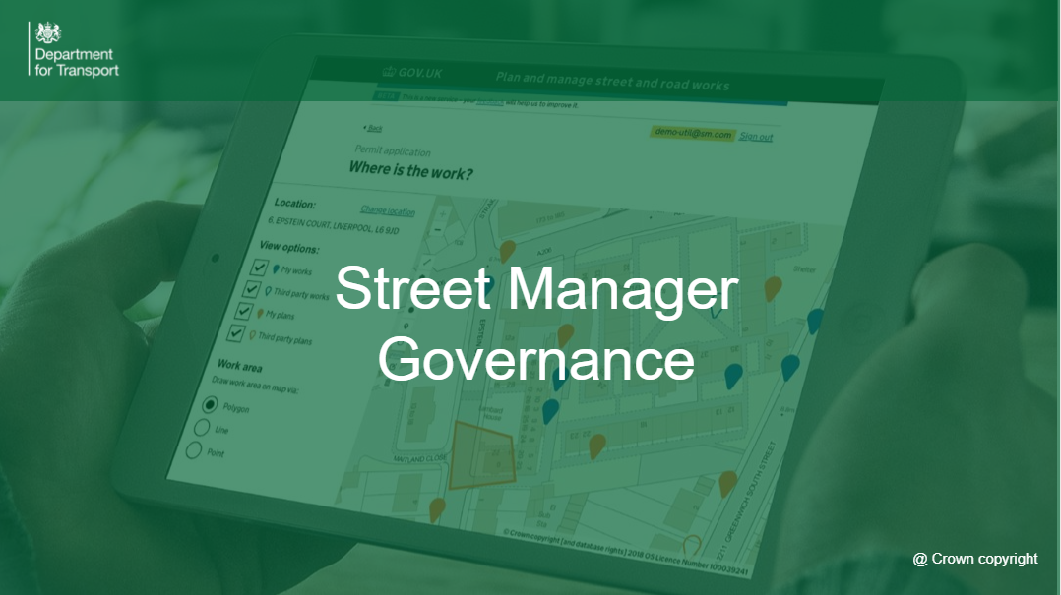

Slide 2
Highway Authority Candidates

Slide 3
Claire Wright – Transport for London (HA)
Having been a part of the Governance group for the last year, I’d like to express my interest to return for a further year.
As a Coordination Manager at Transport for London (TfL) I am a regular user of Street Manager and responsible for a team of Coordination Officers who use the system daily, albeit through an API which has its unique challenges. I have good working relationships with other Highway Authorities and am keen to ensure the needs of London and other complex urban areas are articulated and taken into consideration.
I’m also a lead on Roadworks Technology within TfL and have a vested interest in future improvements to Street Manager which will align with our Network Management Duty and Network Operating Strategy, to improve journeys made by sustainable modes. I would like to continue to explore Lane Rental funding options to help deliver key system improvements.

Slide 4
Alan Haines – Royal Borough of Kensington and Chelsea (HA)
I am seeking to join the DfT Street Manager Governance Group as a Highway Authority representative, bringing 24 years’ experience spanning both Highway Authority and Utility sectors. I have served at RBKC for 18 years as a Street Works Co-ordinator, Inspector and now Team Leader for Street Works Compliance and Highways Licensing. Prior to this, I spent six years within Gas and Electricity as a Noticing Administrator.
This cross-sector background provides me with a comprehensive understanding of legislative compliance, permit scheme governance, noticing accuracy, data quality and the operational realities on both sides of Street Manager. I understand not only how the system functions, but how governance decisions directly influence behaviour, performance metrics, charging, and network risk.
In my current leadership role, I drive compliance strategy across a highly complex, high-profile urban network. I scrutinise performance data, manage inspections and defects, oversee licensing interfaces and challenge processes where they do not deliver regulatory intent.
I am also playing an integral role in introducing Lane Rental within the borough. Street Manager will play a critical role in the successful operation of lane rental schemes across the country and needs to be fit for purpose by ensuring accurate data capture, defensible charging and transparent reporting. I am focused on ensuring governance decisions support consistent, robust Lane Rental functionality aligned with national policy objectives.
I will bring confident, evidence-based challenge, practical insight and strategic focus to the group. My objective is to ensure Street Manager develops in a way that is fair, enforceable, data-driven and operationally credible across the industry.

Slide 5
Jane James - Shropshire Council (HA)
I have worked in Street Works at Shropshire Council for 18 years, during which time I have gained extensive skills and experience in implementing, managing, and developing Shropshire’s Street Works processes. I represent Shropshire Council at WMJAG, HAUC and WaSP forums, and I am Vice Chair of HAUC England. I have a strong working knowledge of NRSWA, the Traffic Management Act, and all associated regulations, codes of practice and guidance.
I have previously been a member of the Governance Group in both 2020 and 2024, and I also acted as a Subject Matter Expert between 2020 and 2022, advising the DfT on how Street Manager should operate to support the aims of the Governance Group and its users. Through this work, I gained a thorough understanding of Governance Group processes and have built strong professional relationships across the industry. These relationships enable me to effectively gather feedback and represent the views of a broad and diverse user base, helping to drive improvements in working practices, performance, collaboration, and Street Manager functionality for both Highway Authorities and Statutory Undertakers.
I have consistently encouraged both staff and Highway Authority colleagues to take part in user research and testing to influence the ongoing development of Street Manager, and I would very much welcome the opportunity to continue this work as a member of the Governance Group. On a personal note, Shropshire is moving away from using an API system and will become a solely UI-based Street Manager Authority from June 2026. This transition will provide me with additional, valuable insight to help inform and guide future development of the service.
I believe I have a great deal to offer in this role and am passionate about delivering improvements that are firmly in the best interests of users, while fully reflecting legislative requirements. For these reasons, I would welcome the opportunity to be re-elected to the Governance Group this year.

Slide 6
Kevin Ferguson – Durham County Council (HA)
I believe I am a strong candidate for continued membership of the Street Manager Governance Group based on both my experience and demonstrated contribution. I have served on the Group since October 2020 and bring an established understanding of its governance framework and decision-making processes.
During my tenure, I have contributed to initiatives including enhancements to the Fee Matrix and Footpath Closure processes, both of which were implemented within Street Manager. I have also supported the wider sector by sharing template documents to assist with Sample Inspection pass/fail rate calculations and contributing to DfT webinars on effective Street Manager data use.
In my substantive post of Street Works Systems Supervisor at Durham County Council, I am responsible for the IT systems supporting Highway Network Management. I led implementation of the Council’s Permit Scheme and the transition to Street Manager, and I continue to work closely with operational users, giving me direct insight into real-world system challenges and opportunities for improvement.
If reappointed, I will continue to represent Northern authorities, ensuring their perspectives are clearly articulated and constructively progressed within the Governance Group.

Slide 7
Michael Clark – Cumberland Council (HA)
I’ve been in Streetworks for over 12 years which has given me a wealth of experience in the life cycle of a permit in Street Manager. Anywhere from Forward Planning/Permit Application to the final registration as a promoter, to the opposite side reviewing permits for a highway authority including issuing FPNs and defects.
I’ve used around 10 unique Streetworks systems throughout my carrer and can give exact reasons as to why features are/aren’t effective or efficient and what can be done better with realistic suggestions for improvement.
In my day to day role as Lead Compliance Officer, I deal with all the rulings and restrictions that are tied into permits. It is imperative I stay up to date with all legislation changes with a thorough understanding to ensure DfT compliance. This translates into great working knowledge of how Street Manager is set up but also makes me aware of areas that it lacks.

Slide 8
Thomas Hicks – Balfour Beatty [East Sussex County Council] (HA)
Working in the Streetworks team at East Sussex Highways for the last 8 years and as Streetworks Compliance Manager for the last 3 I have knowledge and experience within the industry. I feel this will benefit the governance group as I understand the challenges faced daily and would like to work with likeminded members to continuously improve the Street Manager service.
I enjoy building relationships and working collaboratively with HA’s and works promoters. Chairing performance meetings provides understanding of the challenges SU’s face and I feel I would be reasonable in ensuring changes made to Street Manager would benefit all parties.
There is still much to work on and I would like to improve consistency in the way permits are submitted, assessed and inspected and I believe Street Manager is a great tool to manage this.
Hopefully I would bring new ideas and provide feedback on potential improvements to ensure Street Manager continues to grow.

Slide 9
Heath Phillips – Via East Midlands (HA)
I believe I would be a strong addition to the governance group because of my long‑standing experience in Traffic Management and Street Works. I have worked in the Street Works field since 2004, and over that time I’ve built a solid understanding of how the industry operates and what the various parties involved need in order to work effectively.
Early on, I made the decision for my team to use Street Manager directly rather than relying on third‑party software, so I have a very hands‑on understanding of how the system actually works. My experience covers both sides of the process, including raising Permits when necessary and assessing them from the authority perspective. I have also delivered numerous training sessions for new Street Manager users across both promoter and authority roles, giving me insight into the practical challenges people face when using the system.
I would welcome the opportunity to contribute to shaping Street Manager as it continues to develop. I have put forward several suggestions over the years that I believe would improve usability and consistency, and I would value the chance to help influence future improvements through the governance group.

Slide 10
Utility Candidates

Slide 11
Richard Boissieux – UK Power Networks (Utility - Electric)
UKPN covers 3 Regions (East, London and the South East), with 52 Highway Authorities, giving a wide variety of experiences with both authorities and contractors alike.
I have been a member of the Governance Group since the start, actively participating and would welcome the opportunity to continue with this. I am presently chair of the ENA Street Works Forum, chair of the LR EPG and an active member of JUG & HAUC Groups, part of the SWUK Ops Group and Management Team and the Safety Code review.
My role as Street Works Manager at UKPN encompasses the Operational activities as well as governance, charges, performance, systems and compliance giving me a broad breadth of knowledge across the business and the industry that I can draw on.
We are one of the primary API users and understanding and having the opportunity to discuss and influence future changes is key to system developments and the onward compliance with the DfT system, supporting the wider industry view.
Thank you for your consideration

Slide 12
Steve Linacre – Full Fibre (Utility - Telecoms)
Currently employed to lead street works for a telecom SU, I bring over 30 years of comprehensive street works experience, having progressed through roles from Operative to Director across Local Authorities, Statutory Undertakers, and Contractor organisations. This breadth has given me a unique balanced understanding of how functionality, processes, and legislation impact all parties, and what practical requirements best support effective collaboration.
In 2012, I co-built and launched Rotherham Council’s entry into the Yorkshire Common Permit Scheme (YCPS), helping shape its early success. I am widely recognised for my street works passion and for being a specialist in street works legislation, offering open, honest, neutral, and analytical interpretation from planning stages through to reinstatement warranty completion.
My key strengths include improving operational processes, efficiency, compliance, reporting, and partnership working. I build strong and productive relationships by genuinely understanding differing perspectives and bridging gaps between organisations.
I have extensive experience in street works safety gating and have contributed to the development of several industry systems, including Symology’s Aurora. I was the first English organisational user of the system and was jointly nominated for the Street Works UK Project of the Year award in 2022 for supporting development of Symology’s mobile platform.

Slide 13
Richard Kelly-White – Scottish and Southern Electricity Networks (Utility - Electric)
I have been involved in various Streetmanager programs over the past few years and have interacted with Paul Chandler and his team in a positive way through out. I bring an alternate no nonsense approach to meetings and have an ability to distil the information presented into a form that my industry understands. I am robust in my approach and very positive in my outlook, I will benefit the governance group by applying these qualities to ensure an honest and realistic response to issues and improvements.

Slide 14
Hannah Cook – Anglian Water (Utility - Water)
I am now in my 19th year working in Street Works, having begun my career with a traffic management company before joining Essex County Council as a Street Works Inspector in 2008. I remained there until 2019, spending my final four years as Senior Inspector. I then moved to UK Power Networks as a Performance Manager before progressing to Anglian Water in June 2021 as Street Works Manager, a role which has since evolved into Street Works Systems Manager.
Alongside my core roles, I have been an active member of AJAG or AJUG throughout my career, including serving as vice chair of AJUG. A major focus of my work in utilities has been supporting the design, testing, and delivery of new Street Works systems that integrate with Street Manager via API. At UKPN, I was part of the team that successfully delivered a solution for the original Street Manager launch. At Anglian Water, I completed a similar project and recently started to scope future system needs for Lane Rental in line with the Street Manager Roadmap.
I have always been a strong advocate for Street Manager. With senior experience in both local authorities and utilities, I bring a balanced understanding of industry needs and look forward to contributing fresh insight to the governance group for another year.

Slide 15
Utility Contractor Candidates

Slide 16
Tom Lambert – M Group Ltd (Utility Contractor)
I have served on the SM Governance Group now for a number of years representing the contractor community.
I have 35 years experience in the management of streetworks from the inception of NRSWA through all its changes and evolution. I was involved in the development of Street Managers EtON predecessor and have been engaged in the development of streetworks policy and strategies over those 32 years. I have recently stepped down as SWUKs Associate Member Director and will therefore be able to liaise with the contractor community in regards to the outputs from this Streering Group in an effective way creating a wider access base and two way input. I have served on the Governance board for the past 2 years and have ensured the contracting community as far as I am able are kept up to date with developments.
Providing a contractor input into this group around the practical day to day application of Street Manager is essential as the continuously evolving environment of streetworks does need to have some grounding in the “real” world of physical delivery.
I am currently the National Streetworks Manager for Morrison Water Services part of the MGroup with a wider remit across all of our Group companies ranging from Telecoms to Energy and Highway Maintenance.

Slide 17
Scarlet Dos Santos – OCU Group (Utility Contractor)
I am keen to become involved in the Governance Group as I have been an active user of Street Manager since its launch and have developed a strong understanding of both its capabilities and areas for improvement. Having seen the system evolve, I recognise the importance of continuous development to ensure it remains compliant, efficient, and user focused.
In my current role, I am responsible for compliance, performance monitoring, training, and process improvement. I regularly analyse data, build reports, and work across multiple systems, including daily use of Street Manager. With 16 years of experience in street works within the back office.
I understand the challenges faced by users at different levels and can help ensure governance decisions are practical, measurable, and aligned with compliance requirements.
I am confident that my knowledge of the system, analytical skills, and industry experience would allow me to add value to the Governance Group while supporting the continued development and improvement of Street Manager.

Slide 18
HA Promoter Candidates

Slide 19
Emma Oakley – (HA Promoter)
I would like to apply for reappointment to the Street Manager Governance Group. I have been an active member for the past five years and remain committed to supporting the development and governance of Street Manager.
I have been employed by FM Conway for twelve and a half years within the Streetworks Permitting department, during which time I have progressed from Officer to Manager - a position I have held for just over three years.
I recognise that there is only one position available for a HA contractor, and I fully appreciate that my reappointment may not be possible if another candidate wishes to be considered.

