Slide 1
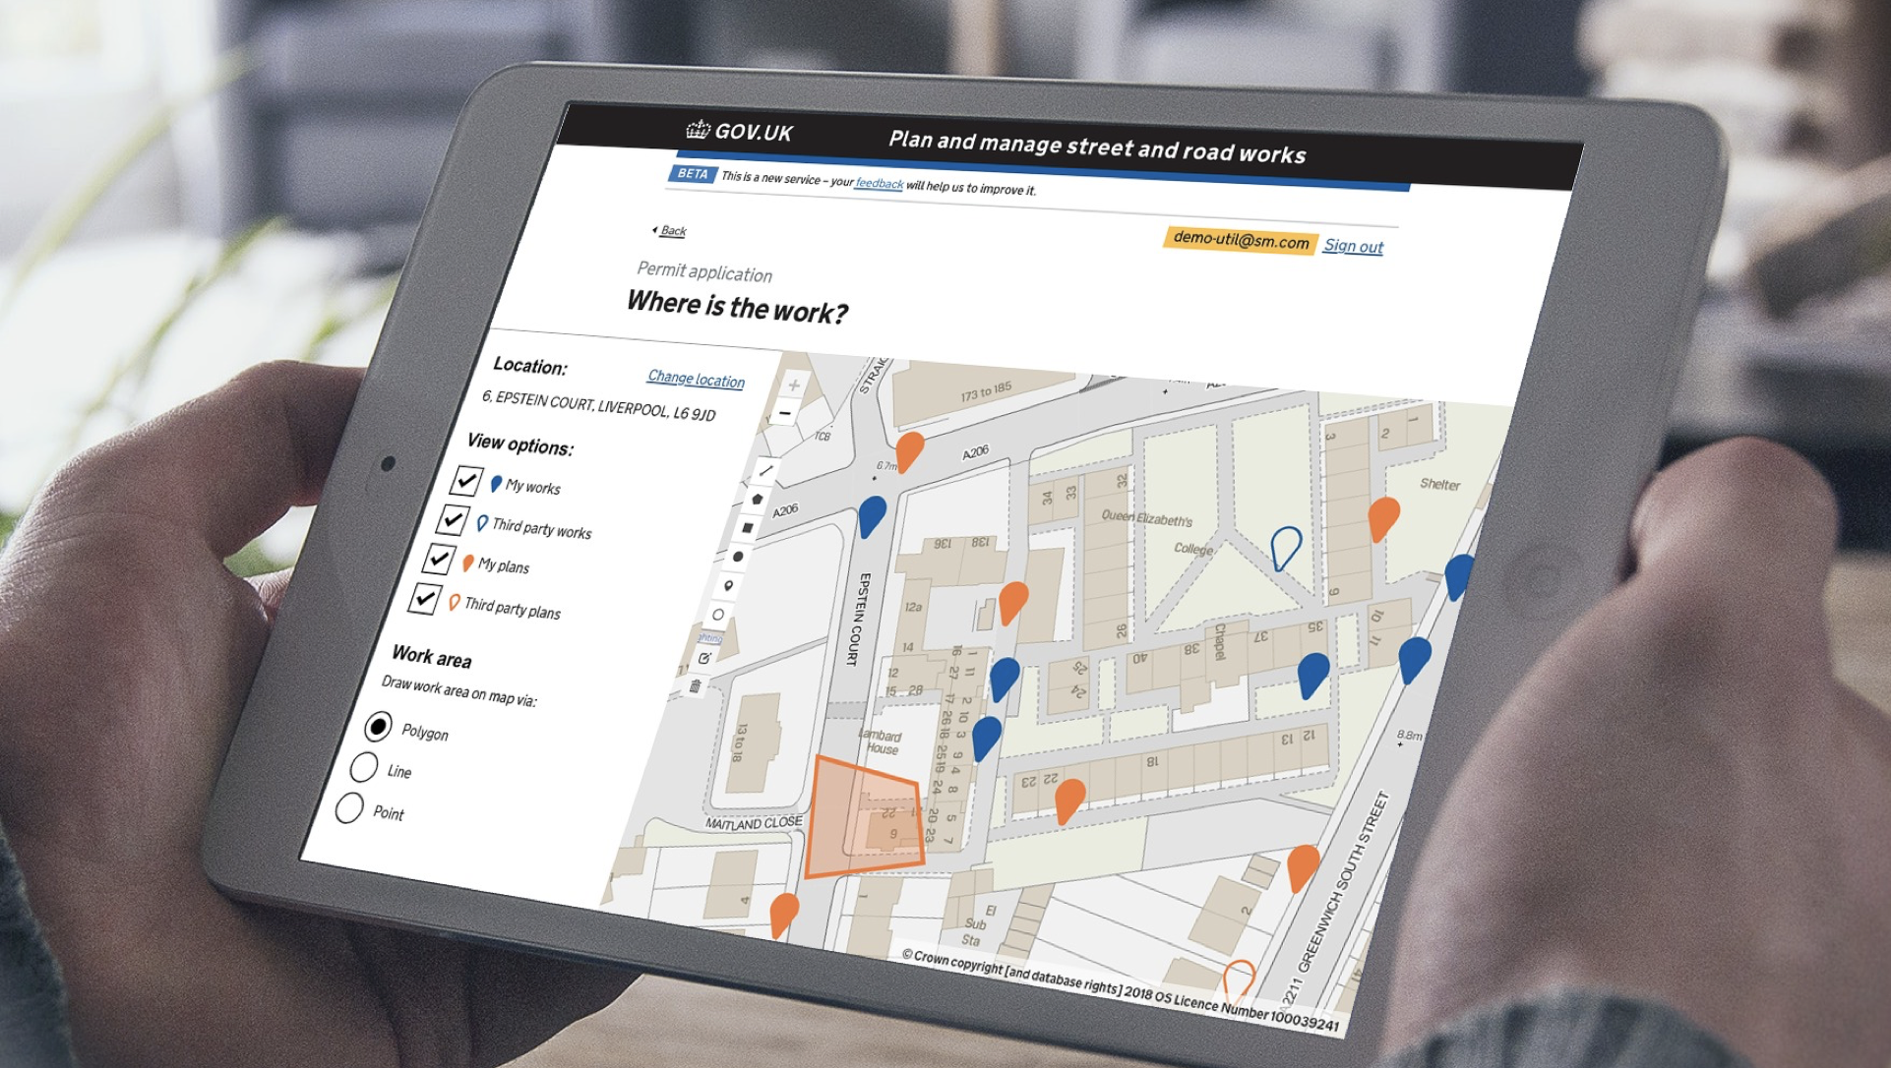

Street Manager Governance
@ Crown copyright

Slide 2
Governance structure
Street Manager Steering group
LHAs:
1 x standing member
(2.5 yr appointment)
4 x user reps
(1 yr appointment
Utilities:
1 x standing member
(2.5 yr appointment)
4 x user reps
(1 yr appointment
Contractor:
1 x user rep
(1 yr appointment)
HA Promoter:
1 x user rep
(1 yr appointment)
CHAIRS:
Paul Chandler DfT
Other industry groups and organisations
Feedback
Design & Technical authority
Subject Matter Experts (SMEs):
2 x HA reps
2 x utility reps
Paul
DfT
Supplier
Feedback
Data, stats, Google Analytics
Feedback/
survey
Street Manager interface
Users

